Slide 1
CP5804 Week 2
Assessment 4A: Week 2 lab
Due tomorrow – 21 July 2019 11:59PM AEST
Assessment 1: Conceptual Database Modelling
Due end of week 5 – 11 August 2019 11:59PM
Assessment 2: Normalisation (15%)
Due end of week 4 – 4 August 2019 11:59PM

Slide 2
Relational tables
two-dimensional structure with rows and columns
rows (tuples) represent single entity
columns represent attributes
row/column intersection represents single value
tables must have an attribute (or attributes) called "key" to uniquely identify each row
structural independent
how data are physically stored is of no concern to the user/designer
values of the same column have same data format (e.g. numeric, character/text, date, logical)
each column has a possible range of values called attribute domain
order of the rows and columns is not important to the DBMS.

Slide 3
Keys
One or more attributes that determine other attributes
Used to:
ensure that each row in a table is uniquely identifiable
establish relationships among tables and to ensure the integrity of the data
The key’s role is based on a concept known as determination, which is used in the definition of functional dependence.
A → B (A determines B. B is functionally dependent on A)‏
‘A is eligible to be a primary key of one table’ means:
Knowing the value of an attribute A makes it possible to determine the value of any other attribute in the table.
Types of keys:
Superkey: Attribute or combination of attributes that uniquely identifies any given row (not necessary to be minimal)
Candidate key (eligible as a primary key): Minimal superkey
Primary key (PK): One of candidate keys selected (can’t contain null entries)
Composite PK: key that is composed of more than one attribute
Key attribute: attribute that is a part of a key
Secondary key: Used only for data retrieval (may NOT be unique)‏
Foreign key: Values must match primary key in another table.

Slide 4
Null values
No data entry
Can represent
An unknown attribute value
A known, but missing, attribute value
A "not applicable" condition
Can create problems when functions such as COUNT, AVERAGE, and SUM are used
Can create logical problems when relational tables are linked
Not permitted in primary key
It would be best if we can avoid using null values even in other attributes. There are some ways used by database designers to avoid nulls.
Flags: Special codes (called ‘flags’ or ‘dummy variables’) used to indicate the absence of some value
NOT NULL constraint - Placed on a column to ensure that every row in the table has a value for that column
UNIQUE constraint - Restriction placed on a column to ensure that no duplicate values exist for that column.

Slide 5
Integrity rules
Entity integrity
All primary key entries are unique, and no part of a primary key may be null
Referential integrity
A foreign key may have either a null entry, as long as it is not a part of its table's primary key, or an entry that matches the primary key value in a table to which it is related; (every non-null foreign key value must reference an existing primary key value)

Slide 6
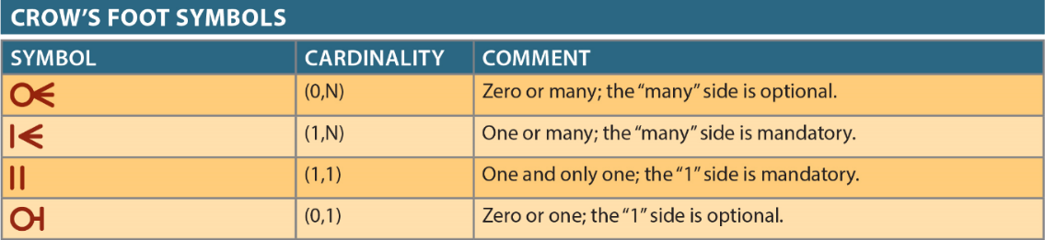

Slide 7
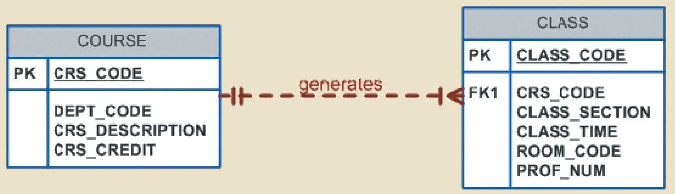
Relationship strength
Weak (non-identifying) relationships
A relationship is ‘weak’ if the PK of the related entity does not contain the PK component of the other related entity - In an ERD, the weak relationship is presented using a dotted line.
In an ERD, the weak relationship is presented using a dotted line.

Slide 8
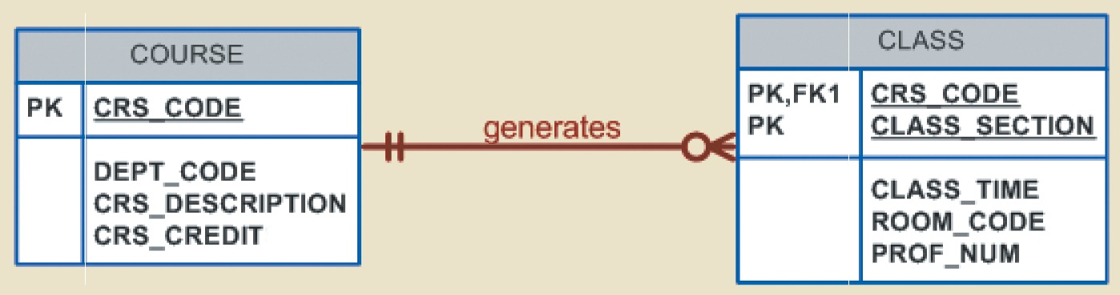
Relationship strength
Strong (identifying) relationships
A relationship is ‘strong’ when the PK of the related entity (called ‘child’ or ‘dependent’ entity) contains any PK component of the other entity (this entity is called as ‘parent entity’)
A strong relationship is presented in an ERD using a solid line
The dependent entity associated in the strong relationship is called as ‘weak entity’
The weak (child) entity is said to be ‘existence-dependent’ on the other entity
The order in which the tables are created and located is very important if this ‘existence dependency’ is the issue in a relationship. (e.g. The Class table cannot be fully completed before the Course table is created, because the PK of Class contains the PK of Course)

Slide 9
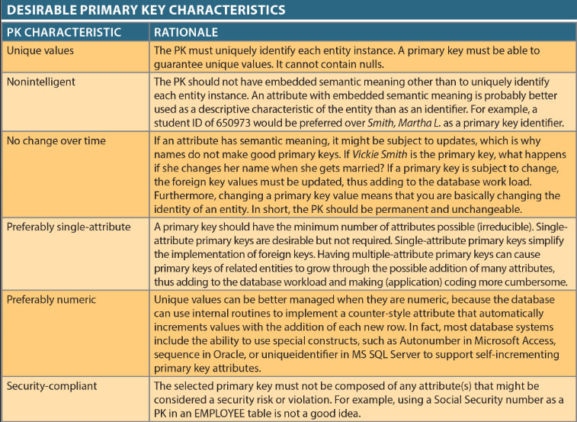

Slide 10
Composite primary keys
Composite primary keys are useful:
For composite entities:
Each primary key combination is allowed only once in M:N relationship
Automatically provides benefit of ensuring that there cannot be duplicate values.
For weak entities:
A weak entity has strong identifying relationship with parent entity
Normally used to represent:
A real-world object that is existent dependent on another real-world object
A real-world object that is represented in data model as two separate entities in strong identifying relationship.

Slide 11
Surrogate keys
Primary key used to simplify the identification of entity instances
Especially helpful when there is:
No natural key
Selected candidate key has embedded semantic contents
Selected candidate key is too long or cumbersome.
If you use surrogate key, ensure that candidate key of entity in question performs properly through use of “unique index” and “not null” constraints.

Slide 12
Example scenario
A veterinary practice would like you to design a database to manage their records.
The practice performs various types of procedures. Each animal that is brought in for a procedure is owned by a customer. Each procedure is managed by a veterinarian. Each animal is a member of a species. Some veterinarians specialise in the care of one or two species. Sometimes animals will need to stay overnight in a lodgement location at the practice.

Slide 13
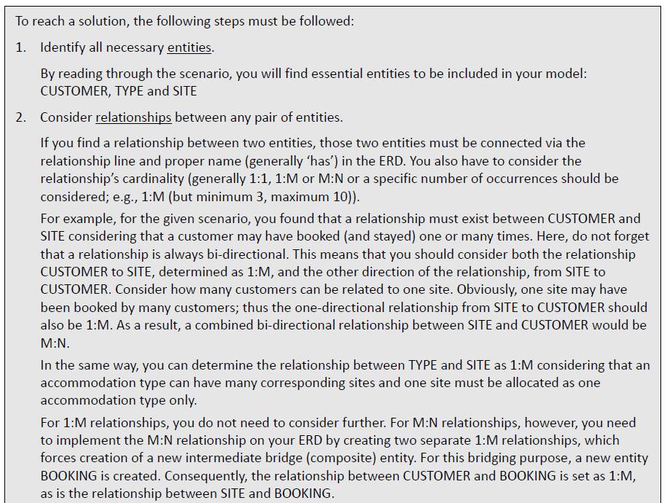

Slide 14
